Slide 1




STOP MOTION DYNAMICS: INFERRING REEF FISH FUNCTIONAL ROLES ACROSS ECOSYSTEM STATES
AARON MACNEIL
NICK GRAHAM
ALISTAIR CHEAL
TIM MCCLANAHAN

Slide 2
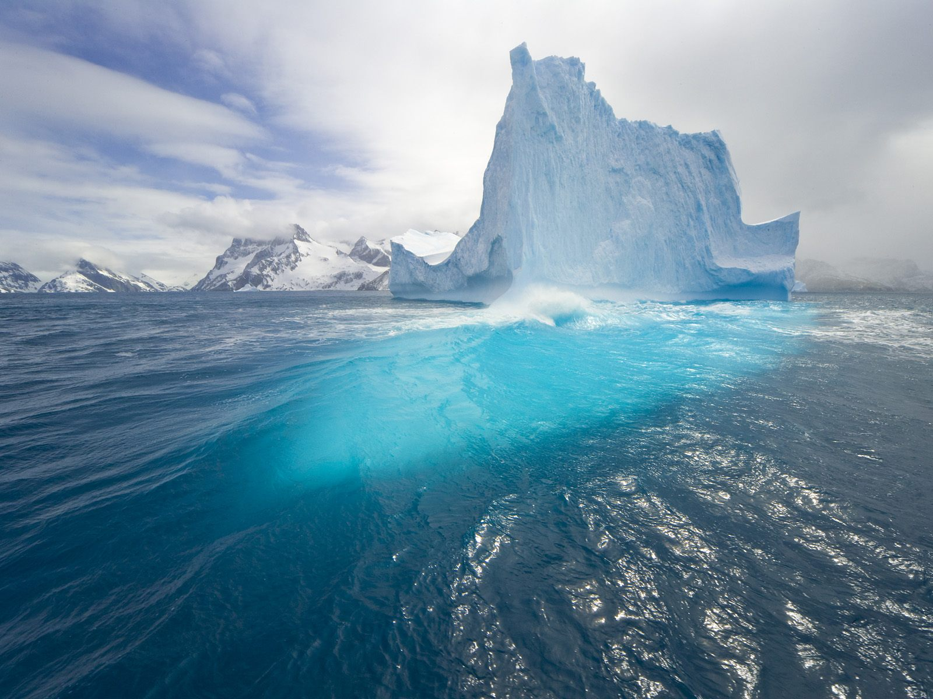
MARINE ECOLOGY
Observed
Unobserved
(a)
(b)
Notes:
Difficulty – unlike on land, we don’t see most of what happens; Processes, individuals etc…
This makes marine ecology hard, for example it is difficult to monitor change through time… we are restricted to field seasons… so we get snapshots / glimses of data to infer what is happening through space and time

Slide 3
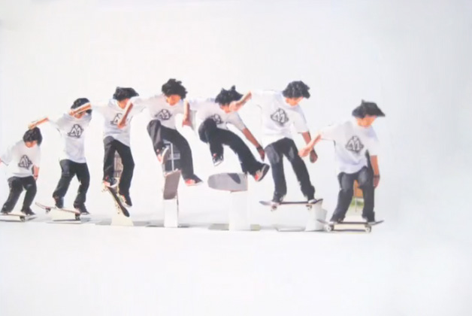
(1) Positive outlook
Notes:
So depending on when you sample you may get different impression – things may seem to be on the way up, for example recovering..

Slide 4
(11) Negative outlook
Notes:
Or going down…. Indicating a possible problem

Slide 5
(111) Stable outlook
Notes:
Or may appear stable

Slide 6
(Random colleague)
(1v) Actual data
2003
2007
(PhD project)
Notes:
If sampling through time… you may have 2 time periods, and then snippets of other data from colleagues.. but they often do not fit well together

Slide 7
(v) Reality (Nollie Inward Heelflip)
Notes:
In reality this ecology is driven by dynamic processes in space and time – which is hard to capture with snapshots of the system…. So how do we put something sensible together

Slide 8
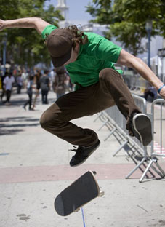
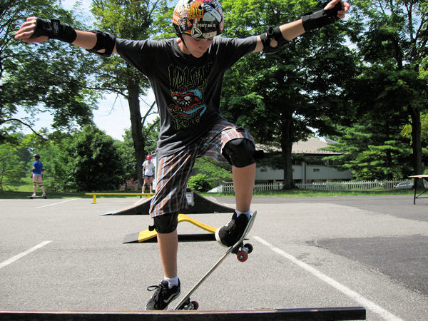
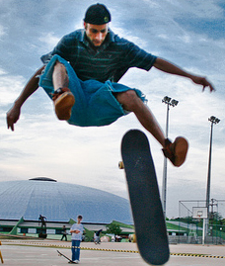
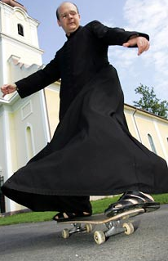
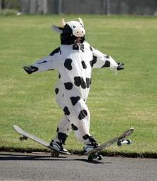
(v1) Something close
Notes:
One option is to put together lots of data from different observers, operating in different places… this can create a more complete picture and capture something closer to reality.

Slide 9
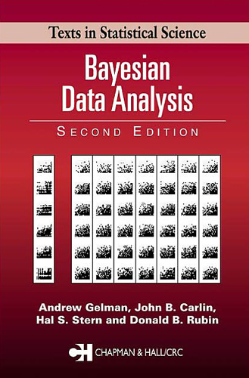
OBSERVATION-BASED INFERENCE
Gelman et al. 2004
‘A well-conducted observational study can provide a good basis for drawing causal inferences, provided that…’
Notes:
We use Bayesian techniques to attempt to do this – One of the key players in this field is Andrew Gelman at Columbia University – who argues…

Slide 10
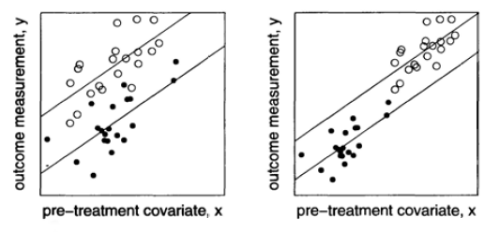
OBSERVATION-BASED INFERENCE
(1) Reasonable overlap
Yes
No/maybe
Notes:
Need to have good coverage of data – for example reasonable overlap of treatments and controls or across gradients of dependant variables and drivers. For example, if have data on low hervibory on one reef that has shifted to algae, and on another reef with high herbivory and high coral, but no overlap in data exists, then it is difficult draw causal attribution…even where it may be present

Slide 11
OBSERVATION-BASED INFERENCE
(11) Have ‘a lot’ of data
Yes
No
Notes:
Need to have lots of data – if data are sparse, can not say a lot

Slide 12
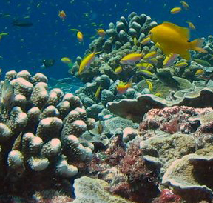
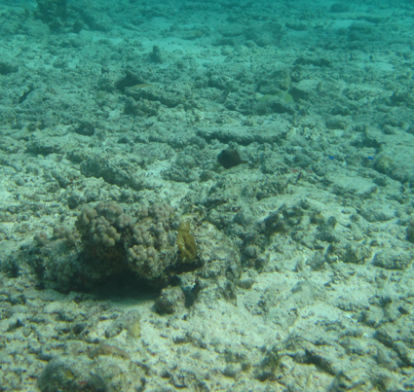
OBSERVATION-BASED INFERENCE
(111) Data collected ignorantly
Yes
No
Treatment Control
Treatment Control
Notes:
Data need to be collected independently - ideally random, so drivers and effects are independent

Slide 13

OBSERVATION-BASED INFERENCE
(1v) Tame missing data
Yes
No
Treatment Control
Treatment Control
sample from
posterior
Notes:
Can handle missing data in a useful way. For example re-sample from the posterior distribution of sampled data you do have, to estimate with uncertainty what you missed.

Slide 14
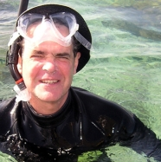
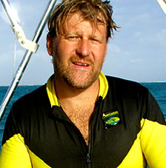

OBSERVATION-BASED INFERENCE
(v) Acknowledge data collection
Yes
No
Notes:
Model the way the data collected.. For example you may include country as a covariate to see if this is important for the data, or model potential bias among observers.

Slide 15
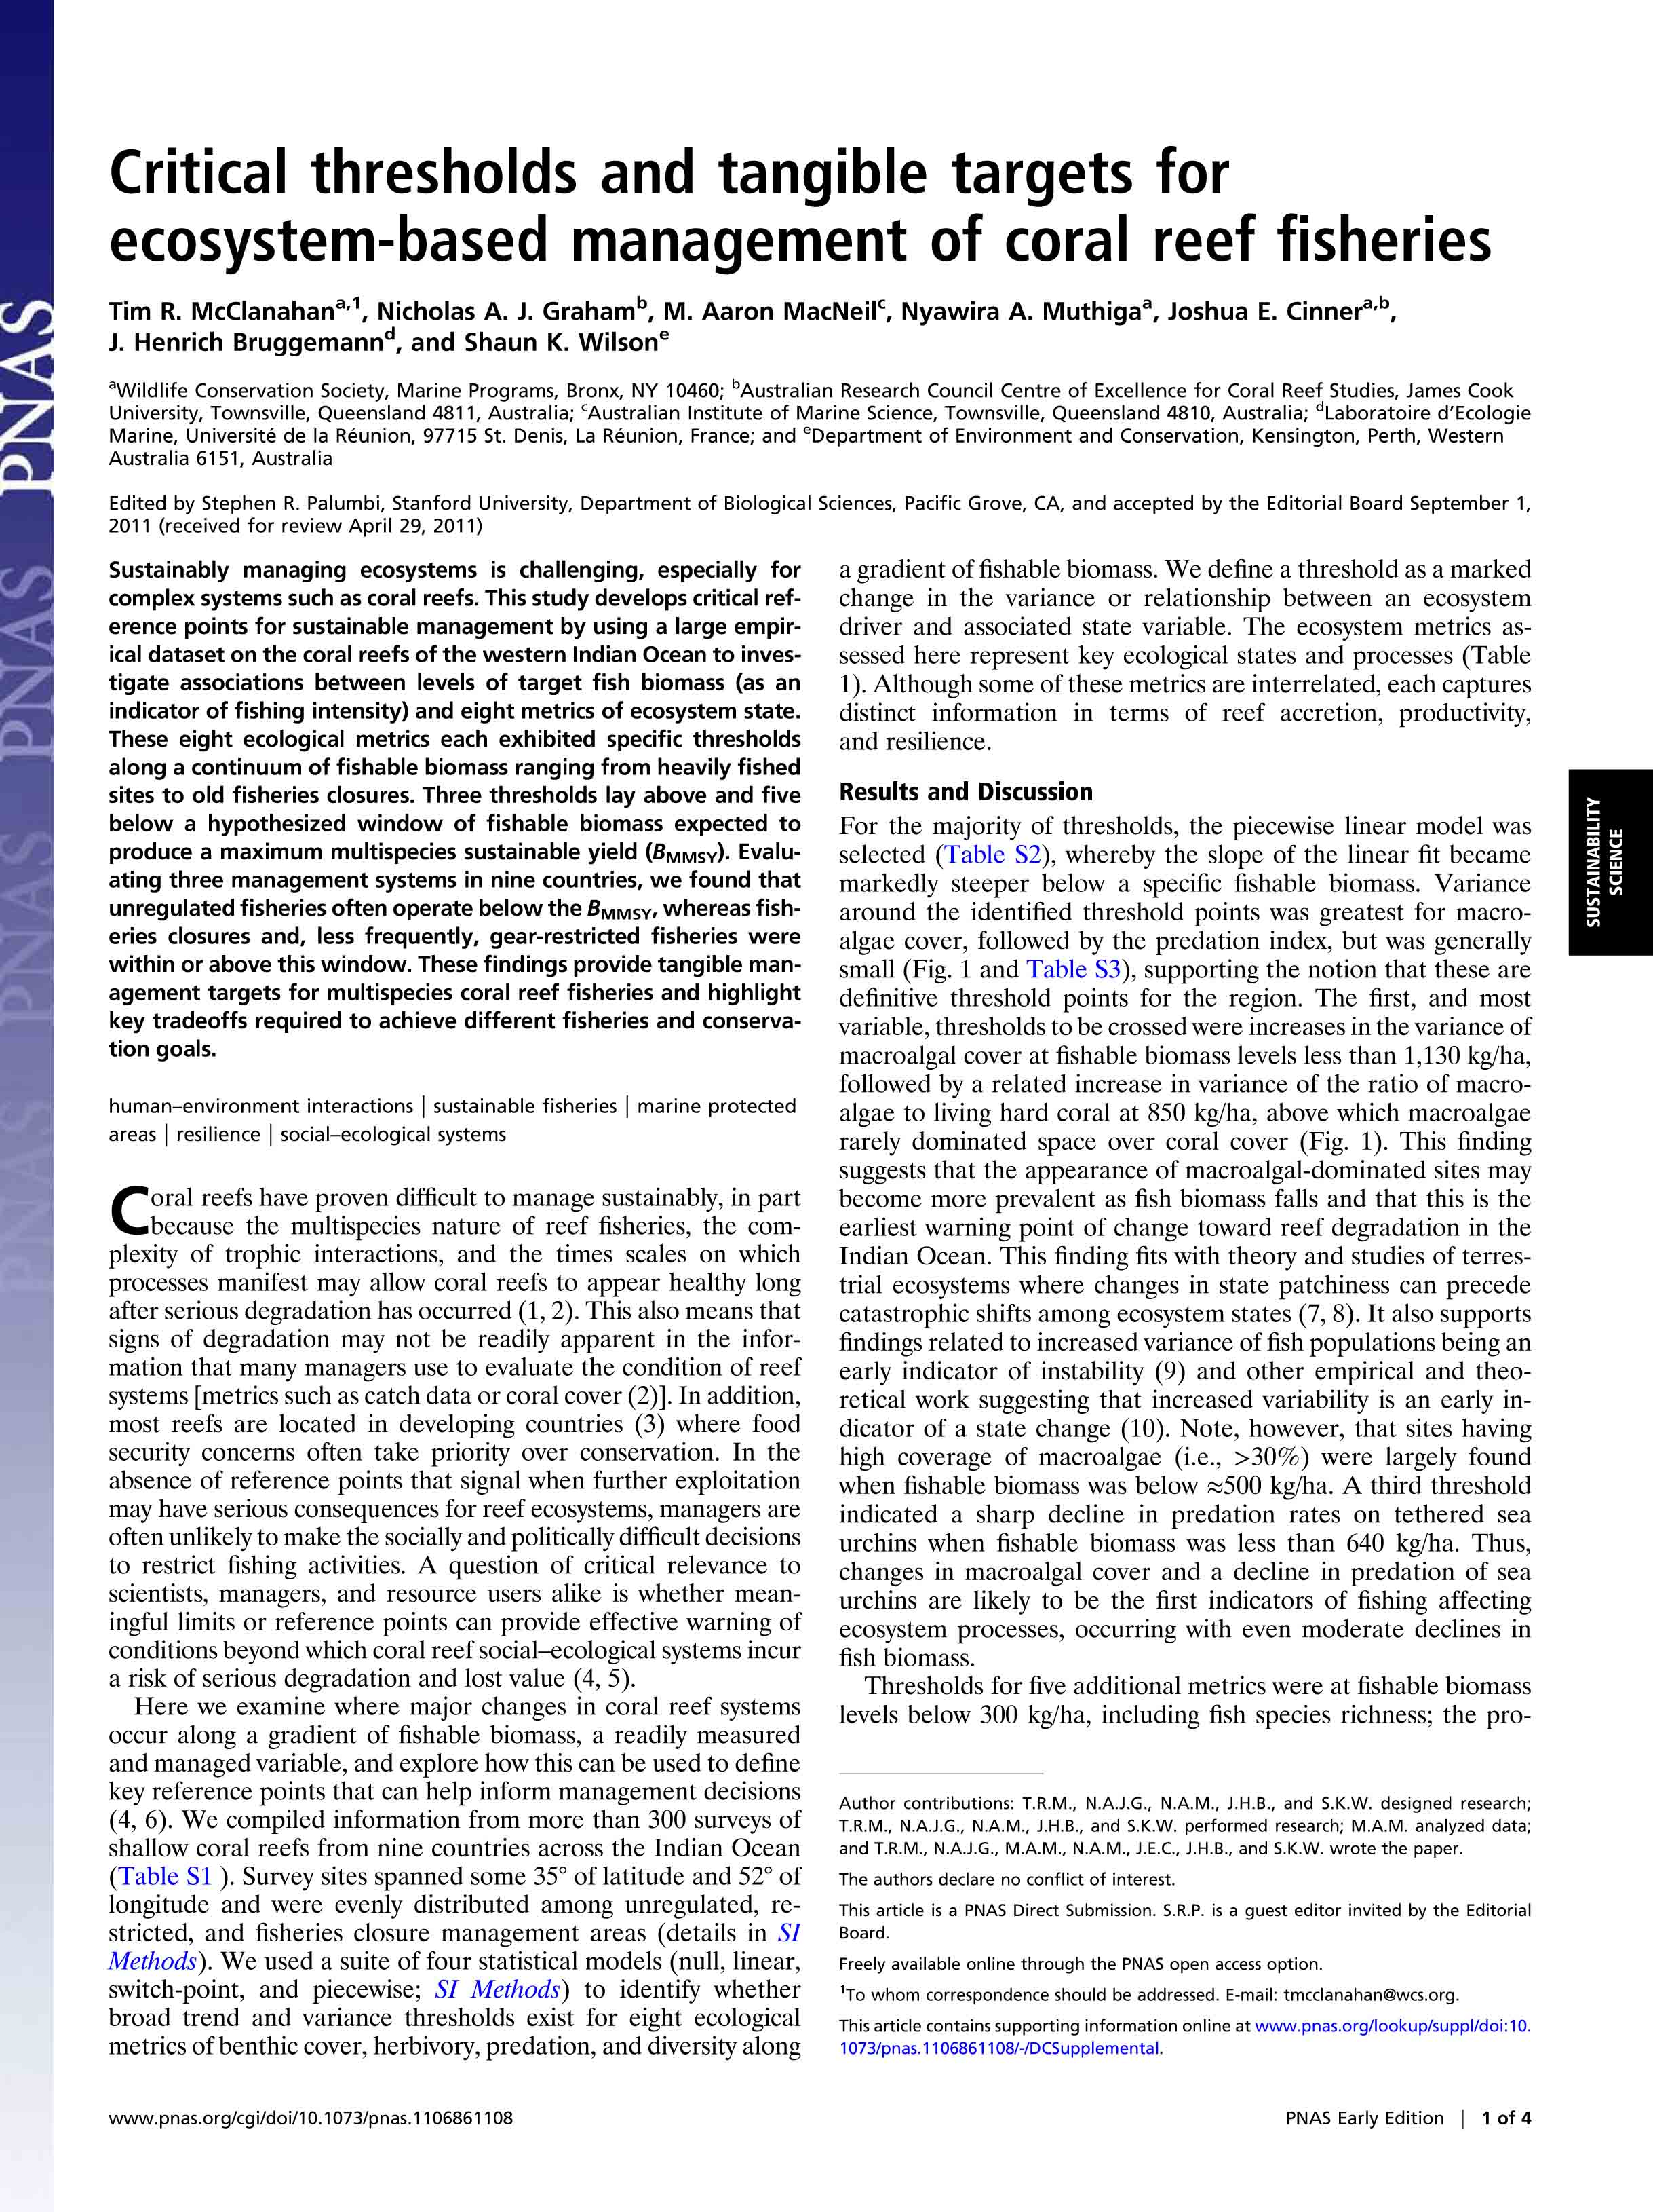
MULTISPECIES REEF FISHERIES
Notes:
We have dealt with each of these issues in this recent paper….

Slide 16
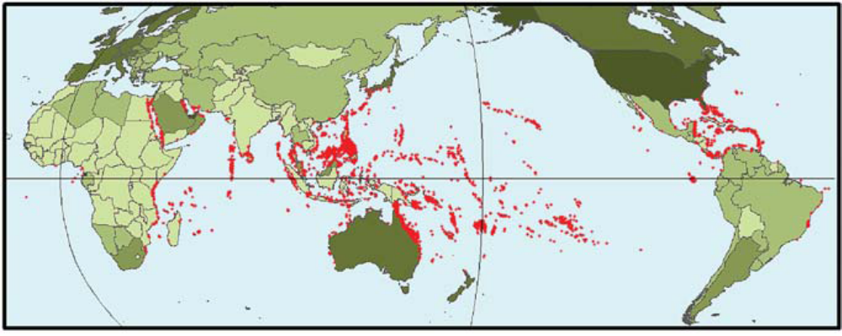
SURVEYS AND ANALYSES
Compiled >300 surveys of shallow coral reefs from nine countries across the Indian Ocean.
Evenly distributed among unregulated, restricted and no-take marine protected areas
Used a suite of Bayesian switchpoint models to test for trend and variance thresholds

Slide 17
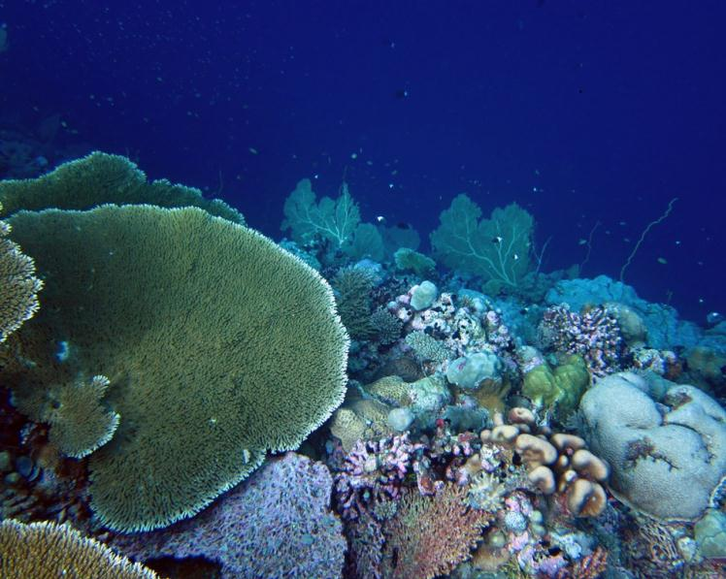
CAN THRESHOLDS BE IDENTIFIED
Various indicators
State Variable
Driver
Measurable indicator
& tangible for management

Slide 18
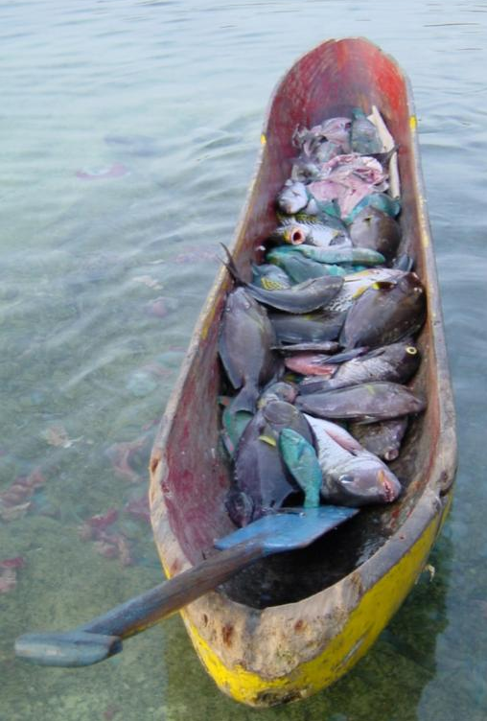
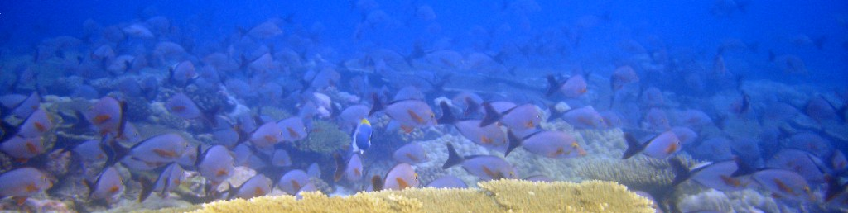
ECOSYSTEM DRIVER
Fishable Biomass (kg/ha)
Intimately linked to fishing and overfishing known to have serious repercussions for the ecosystem
Importantly, it is tangible & influenced by managers and resource users

Slide 19
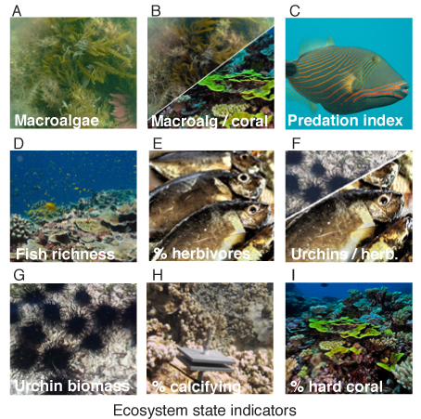
ECOSYSTEM STATE INDICATORS
Used ecosystem metrics that represent key ecological states and processes thought to influence ecological shifts
McClanahan et al. 2011 PNAS

Slide 20
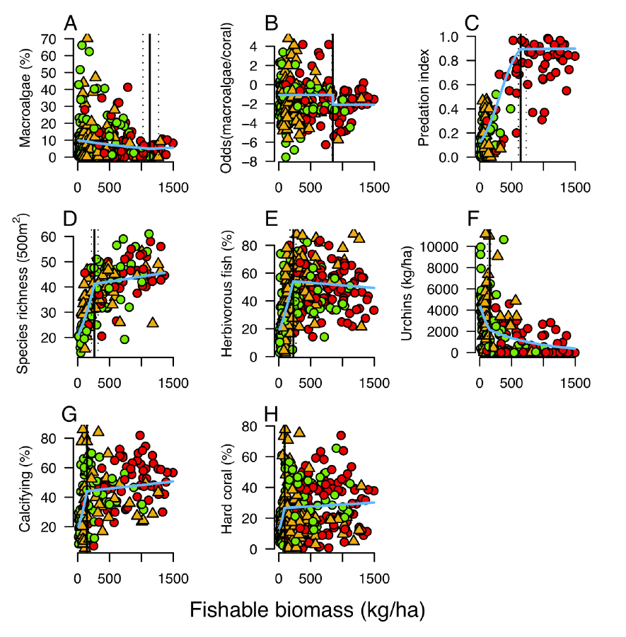
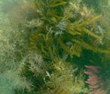
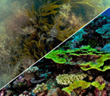
Macroalgae
Macroalg / coral
McClanahan et al. 2011 PNAS
MPA
Gear rest.
Open

Slide 21
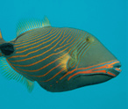
Predation index
McClanahan et al. 2011 PNAS
MPA
Gear rest.
Open

Slide 22
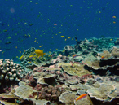
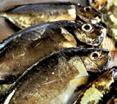
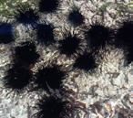
Fish richness
% herbivores
Urchin biomass
McClanahan et al. 2011 PNAS
MPA
Gear rest.
Open

Slide 23
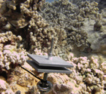
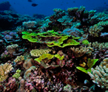
% calcifying
% hard coral
McClanahan et al. 2011 PNAS
MPA
Gear rest.
Open

Slide 24
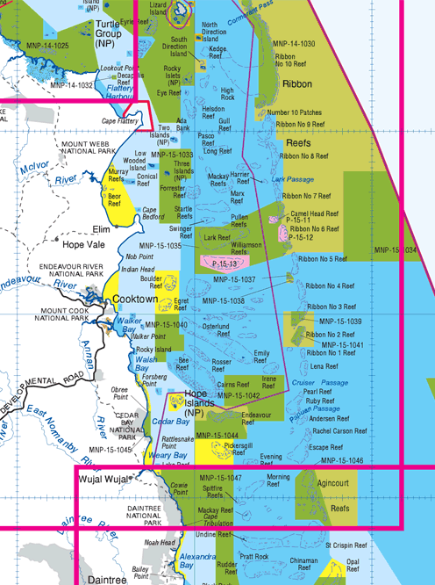
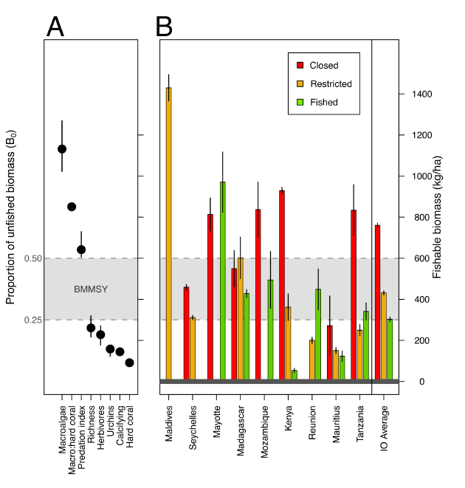
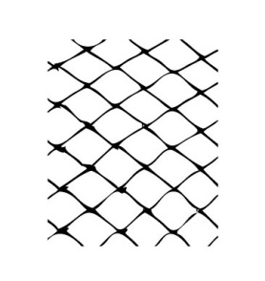
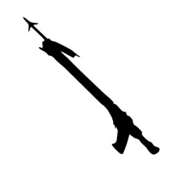
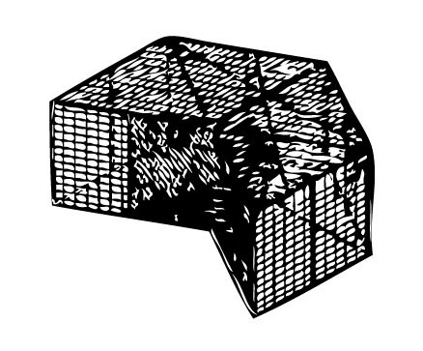
REGIONAL PERFORMANCE
McClanahan et al. 2011 PNAS

Slide 25
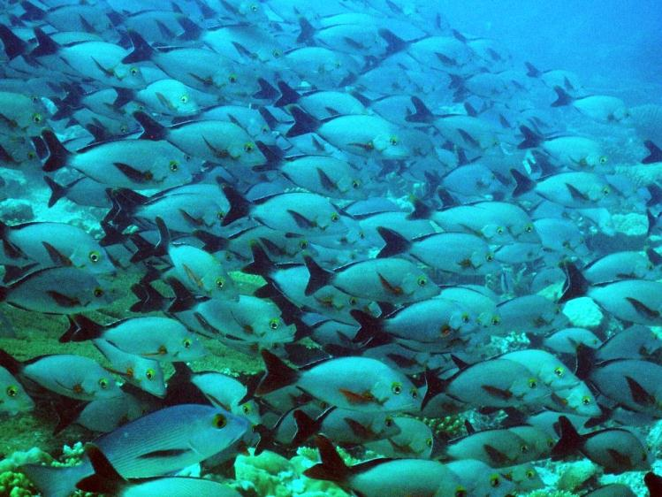
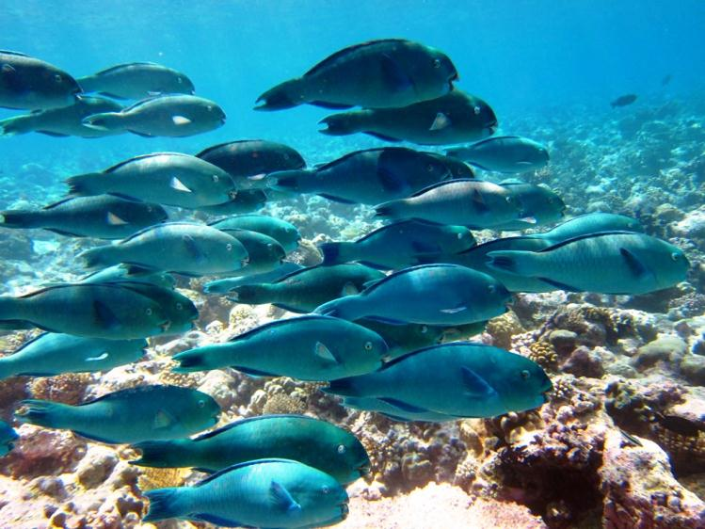
CONCLUSIONS
This talk presented concepts of how to infer patterns on reefs whilst acknowledging and trying to sensibly model the imperfect data we have available
In such a way, large data sets may be utilized to tackle complex patterns in ecology

Slide 26
STOP MOTION DYNAMICS: INFERRING REEF FISH FUNCTIONAL ROLES ACROSS ECOSYSTEM STATES
AARON MACNEIL
NICK GRAHAM
ALISTAIR CHEAL
TIM MCCLANAHAN
Notes:
We are talking about the concepts of how to infer patterns on reefs whilst acknowledging the imperfect data we have available

